Slide 1


STYLEST
Application

Slide 2

StyLESt Project
Presentation Content
Motivation - The Whys
Identifying the Problem - The Hows
Prototype Design - The looks
Evaluation - The Results
Conclusion - The Learnings

Slide 3


Why: The Motivation
What problem did we want to solve?
StyLEst addresses challenges in online fashion and beauty shopping by offering a streamlined, user-friendly platform with a curated selection of products, personalized recommendations, and a vibrant community for fashion inspiration.

Slide 4

How: Identifying the Problem
How did we identify the problem?
The problem was identified through market research, user feedback analysis, and industry trend observation, revealing consumer challenges in online fashion and beauty, and identifying opportunities for StyLEst to provide a superior shopping experience.

Slide 5
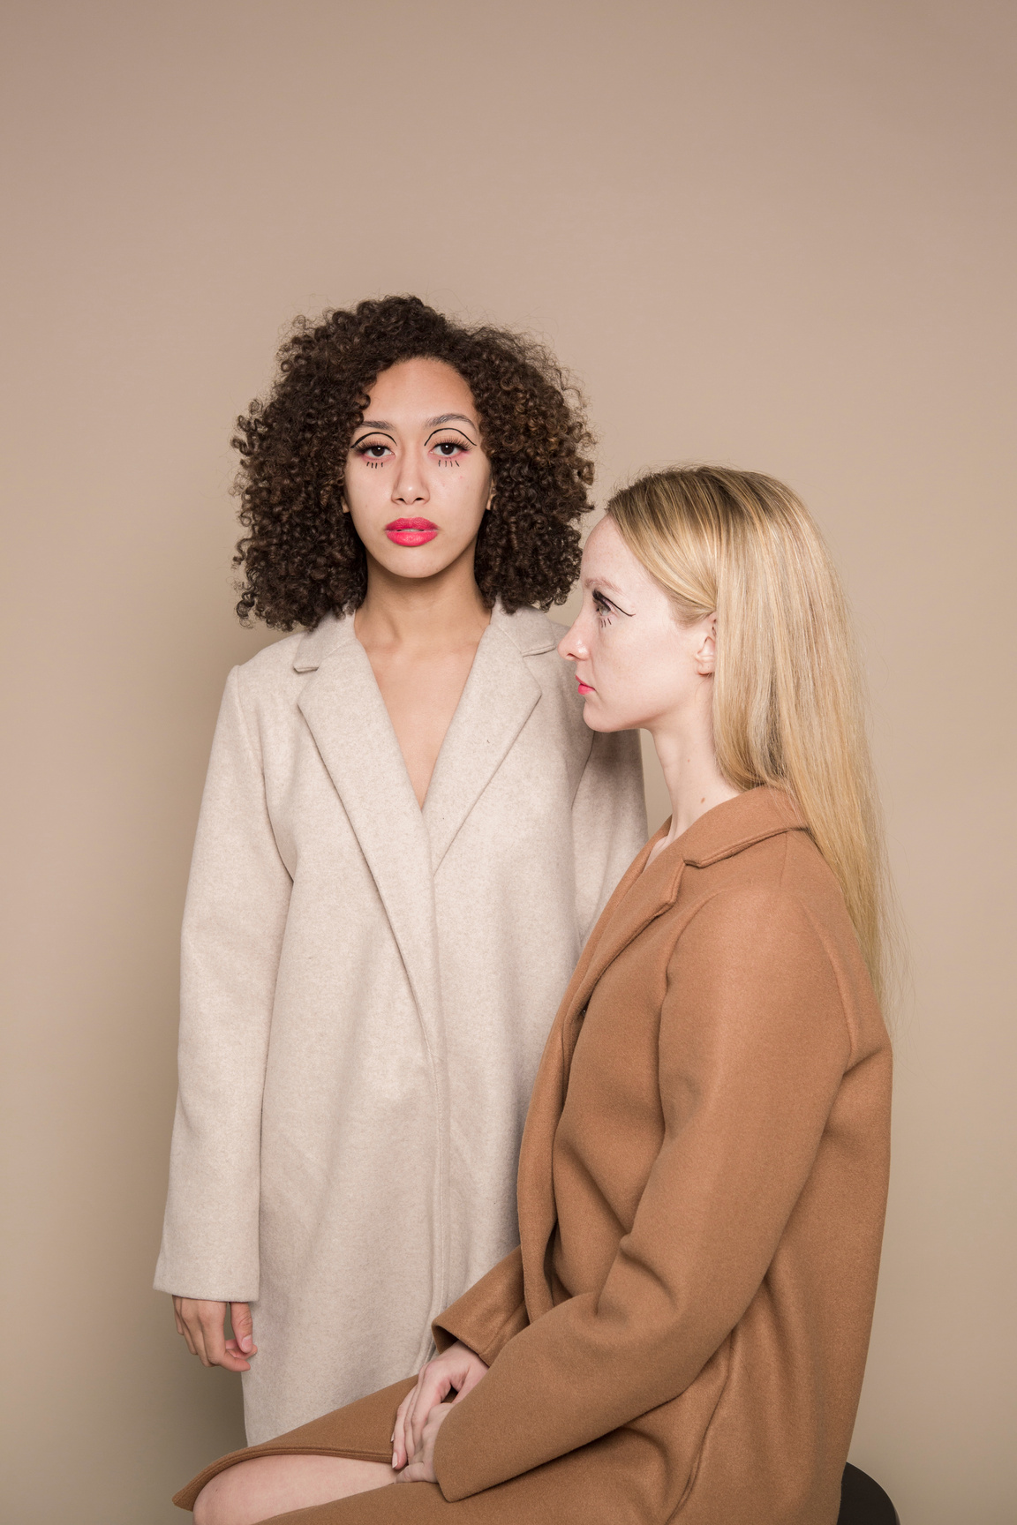
Methods
For our prototype survey, we will utilize Google Forms to collect data efficiently. Participants will be asked to provide their feedback through a series of questions designed with a 5-point Likert scale. This scale will allow respondents to rate their experience as follows: 5 - Great, 4 - Decent, 3 - Good, 2 - Not Good, and 1 - Not Great. This structured feedback will provide us with valuable insights to refine our prototype.

Slide 6
Result of the survey
3.70
4.10
3.80
OVERALL EXPERIENCE
UI DESIGN
EASE OF FOLLOWING TASKS
Users generally found the prototype to be satisfactory, indicating room for improvement to enhance the overall user experience.
The user interface design received positive feedback, suggesting that the visual and interactive elements of the app are well-received by users.
Participants found it relatively easy to follow the tasks provided, showing that the app's navigation and instructions are fairly intuitive.

Slide 7

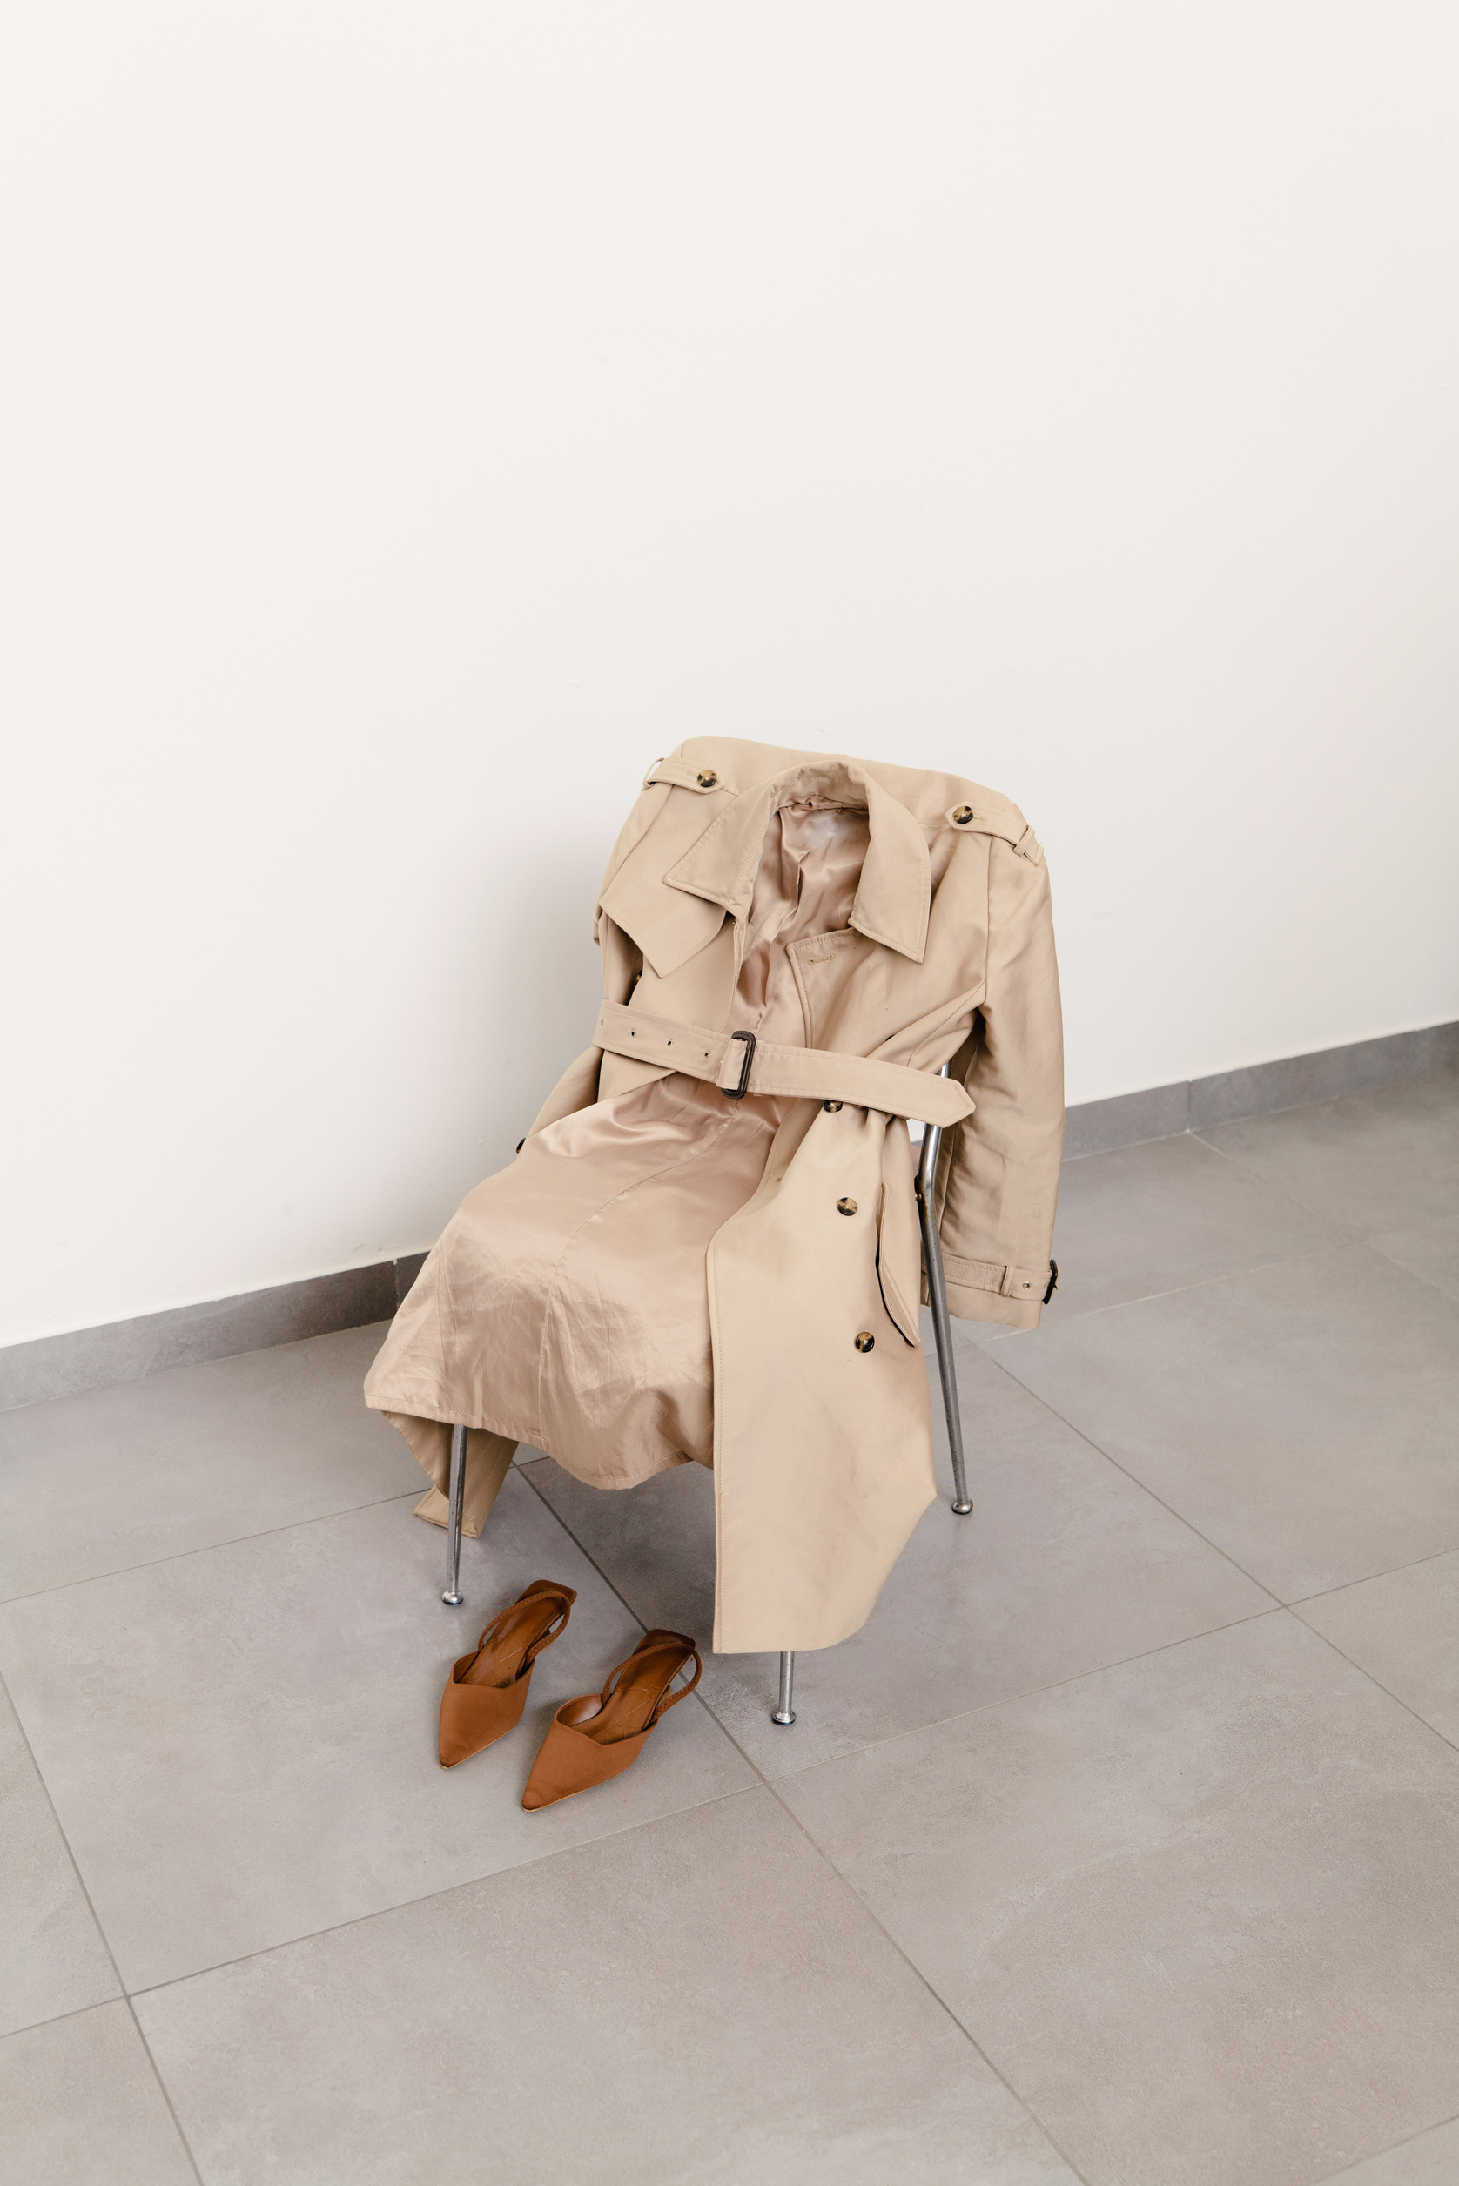
BRIEF DESCRIPTION
StyLEst is a user-friendly fashion and beauty app that provides a curated selection of stylish items, personalized recommendations, and a vibrant community for fashion enthusiasts.
PROTOTYPE OBJECTIVE
StyLEst is a prototype project aimed at developing a functional app showcasing curated fashion and beauty products, integrating personalized recommendations, and fostering community engagement.

Slide 8
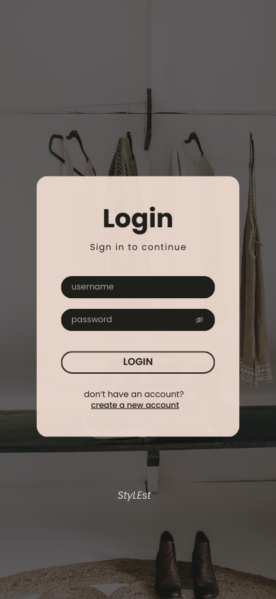
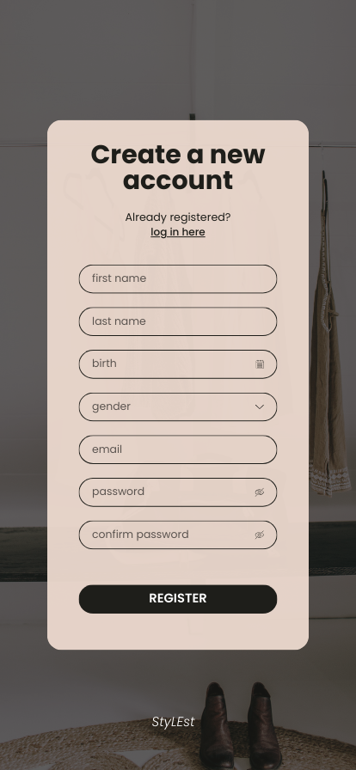
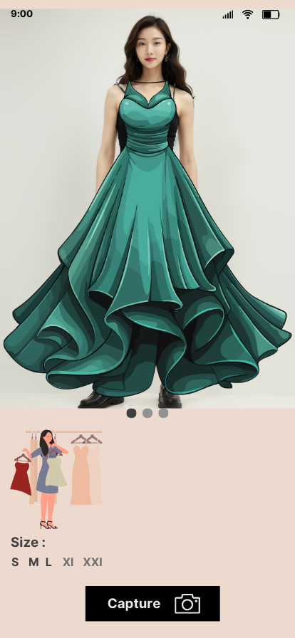
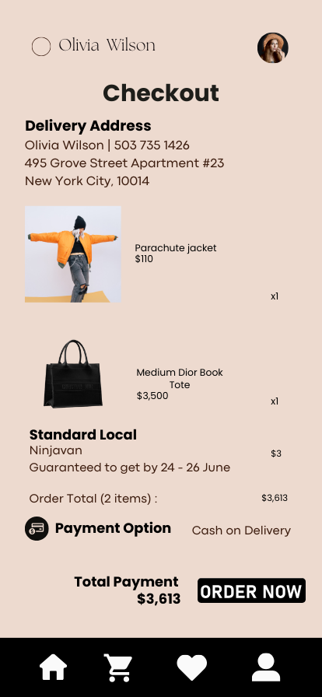
PROTOTYPE DESIGN

Slide 9
PROTOTYPE
DESIGN
Font
NAVIGATION
Minimalistic
CANVA
The StyLEst prototype's navigation system prioritizes user ease and familiarity, with essential sections like Home, Shop, Search, My Account, Cart, Community, and Help & Support. The app's consistent navigation bar and interactive elements enhance usability.
Our StyLEst prototype features a minimalist design, focusing on simplicity and elegance, enhancing usability and a seamless online shopping experience for fashion and beauty enthusiasts.
The font used in this prototype is Poppins. This makes texts clear and easy to read.
This prototype is designed in CANVA. This enables the team to provide participants with a copy that they can interact with themselves, ensuring an unbiased evaluation.

Slide 10



06/10
TRY ON PRODUCTS
Features:
ADD TO CART PRODUCTS
WHAT CAN IT DO?
CHECKOUT PROCESS
PROFILE MANAGEMENT

Slide 11
Evaluation Plan
PREPARE
LAUNCH
EVALUATE
DISCUSSION
CONCLUSION
The team will be working on the prototype link, the participant survey, and the availability schedule for the chosen individuals.
To avoid a biased judgment, the participants will engage with the prototype through the prototype link.
To assess the
prototype, the
Participants in the
group will be
keeping an eye on and
Give directions.
to the individuals taking part.
Additionally, the survey will
participate in the
assessment in addition to the Heuristics.
Assessment.
Following the collection of the
outcomes, the group will talk about the
outcomes that were
gathered inside the
assessment.
The group will be
delivering their last
ideas, criticism,
and offer responses
where the model was located
probably require space for enhancements.

Slide 12
METHODS OF EVALUATION
USABILITY
SPECIFICATIONS
HEURISTICS
EVALUATION
SURVEY AND FEEDBACK
The StyLEst prototype's usability specifications prioritizes functionality, efficiency, and accessibility, offering clear navigation, unified visual language, responsive design, robust feedback mechanisms, and fast loading times.
The StyLEst prototype will be evaluated using Nielsen's Heuristics. This method will ensure a professional assessment of the application's usability and design.
User feedback on StyLEst prototype demonstrates satisfaction with intuitive interface, product details, personalized recommendations, customer support, and aesthetic design, enhancing usability and trust.

Slide 13
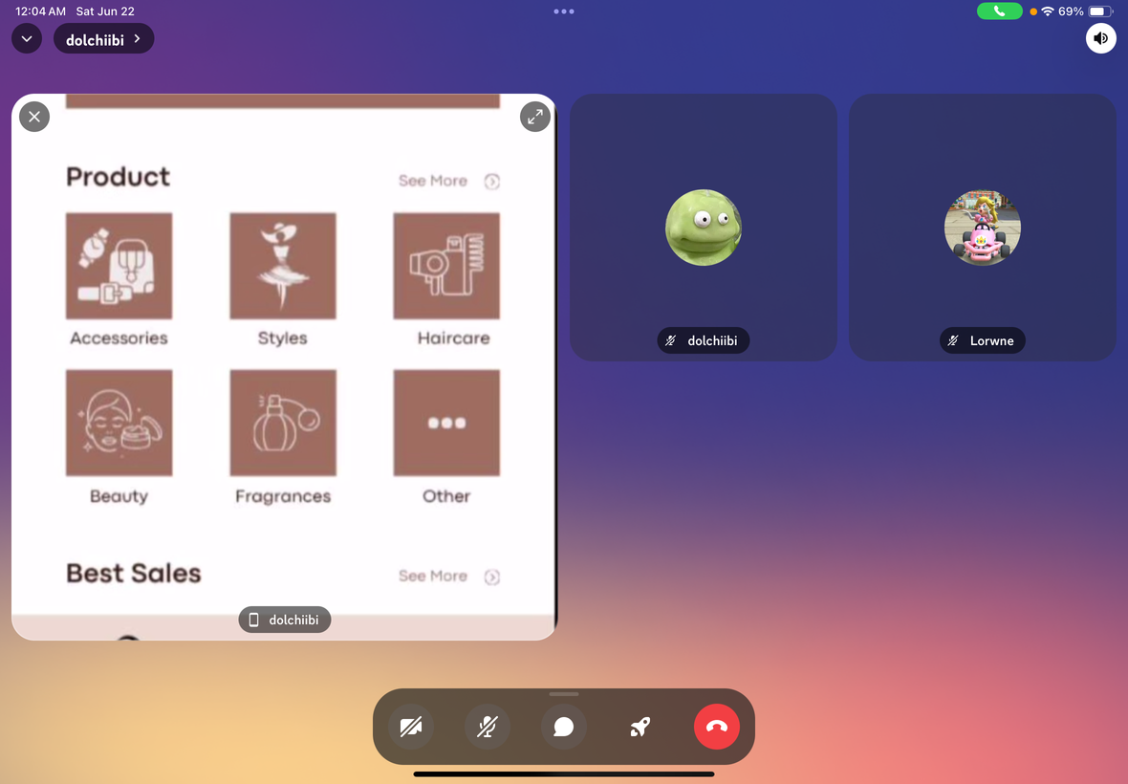
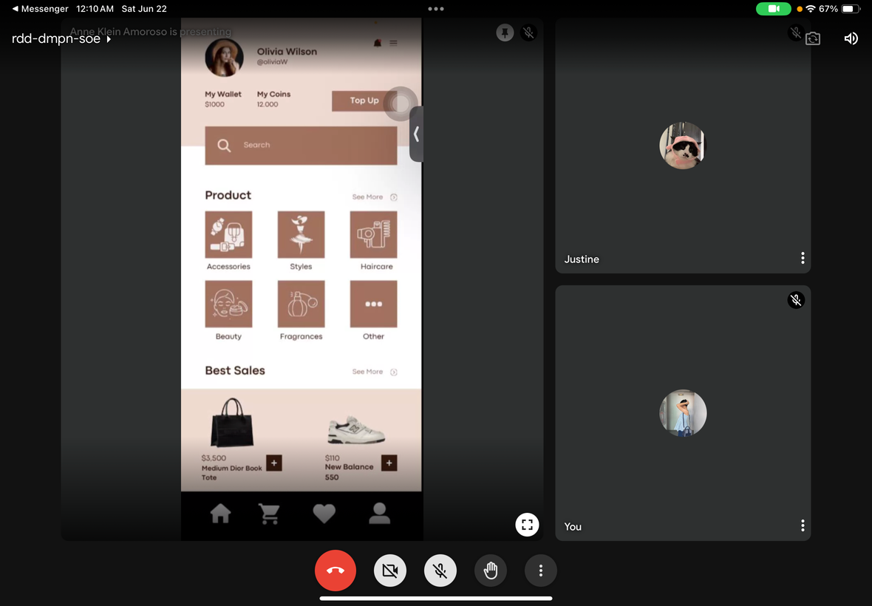
ONLINE TESTING WITH PARTICIPANTS
DISCORD
GOOGLE MEET

Slide 14
USABILITY SPECIFICATIONS
0.45 min
1 min 30 sec
2 min 45 sec
Highly Acceptable!
Highly Acceptable!
Highly Acceptable!
MAIN MENU TASK
SHOPPING CART
CHECKOUT
With minimal to no difficulty, the participants were able to efficiently browse the Main Menu Section. The user-friendly style and selections made it easy for users to navigate between areas.
The participants handled the shopping cart's contents with ease and added goods to it. Overall, the activities were finished in a very respectable amount of time.
Participants had some little trouble submitting shipping information the first time, but other than that, the payment process went well. The process was completed quickly and easily, and the clear order summary and multiple payment alternatives enhanced the user experience.

Slide 15
OBSERVATIONS
The following observations were made during the
evaluation.
STYLEST features an intuitive interface, making it easy for users to navigate through its various sections, much like a familiar shopping application.
The application is designed with a user-friendly layout, ensuring that users can quickly find and use its features without any confusion.
Users can effortlessly browse and interact with STYLEST, thanks to its design that mimics the straightforward and engaging experience of a shopping app.

Slide 16
HEURISTICS EVALUATION
HOW WELL DID THE PROTOTYPE PERFORM USING HEURISTICS EVALUATION?
The StyLEst prototype, evaluated using Nielsen's 10 Usability Heuristics, offers a user-friendly shopping experience. It communicates system status, aligns with users' mental models, and uses familiar language from the fashion and beauty industry. The app empowers users with control and freedom through error recovery options and consistent interface elements. Consistency in design elements, terminology, and interaction patterns ensures predictable navigation and error prevention. The design prioritizes visibility and self-explanatory features, catering to different user needs. The aesthetic and minimalist design showcases products effectively, while comprehensive help resources provide prompt assistance. Overall, the StyLEst prototype delivers a user-friendly shopping experience.

Slide 17
CONCLUSION
Innovative Solution: With its extensive features, StyLEst addresses typical user annoyances and presents a fresh way to online fashion and cosmetics purchasing.
Comprehensive Features: StyLEst strives to be a one-stop platform with unified search, comprehensive product information, user-generated content, and future-ready technology.
Favorable User Impact: According to usability research, StyLEst has the potential to be a market leader by offering a simple, effective, and pleasurable purchasing experience.

Slide 18
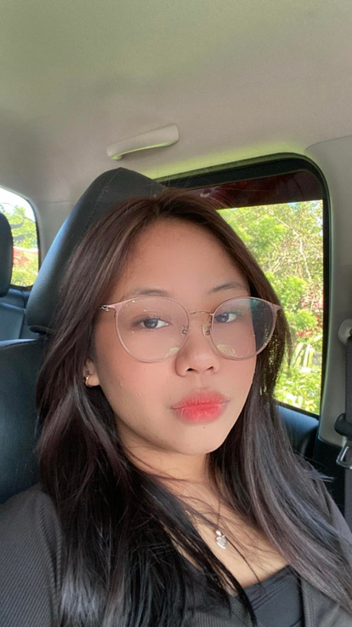
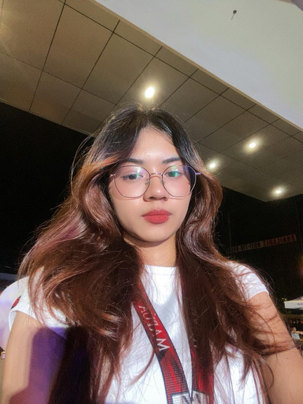
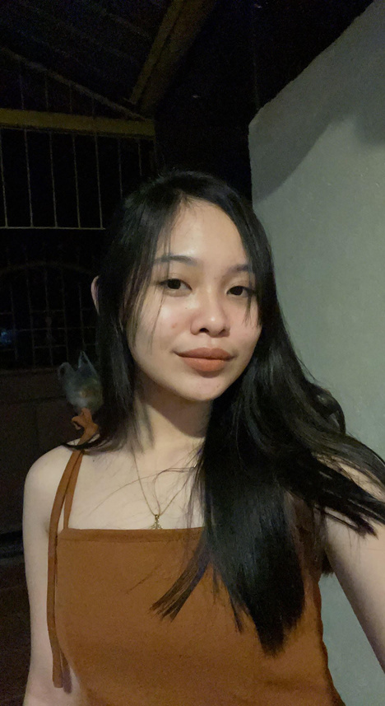
TEAM ABA MEMBERS
Monica
ANNE KLEIN F.
AMOROSO
ANSHARLENE CRYSTAL C. BALAGOSA
MARCHELLE D.
ATIENZA

Slide 19
Thankyou!

